Slide 1
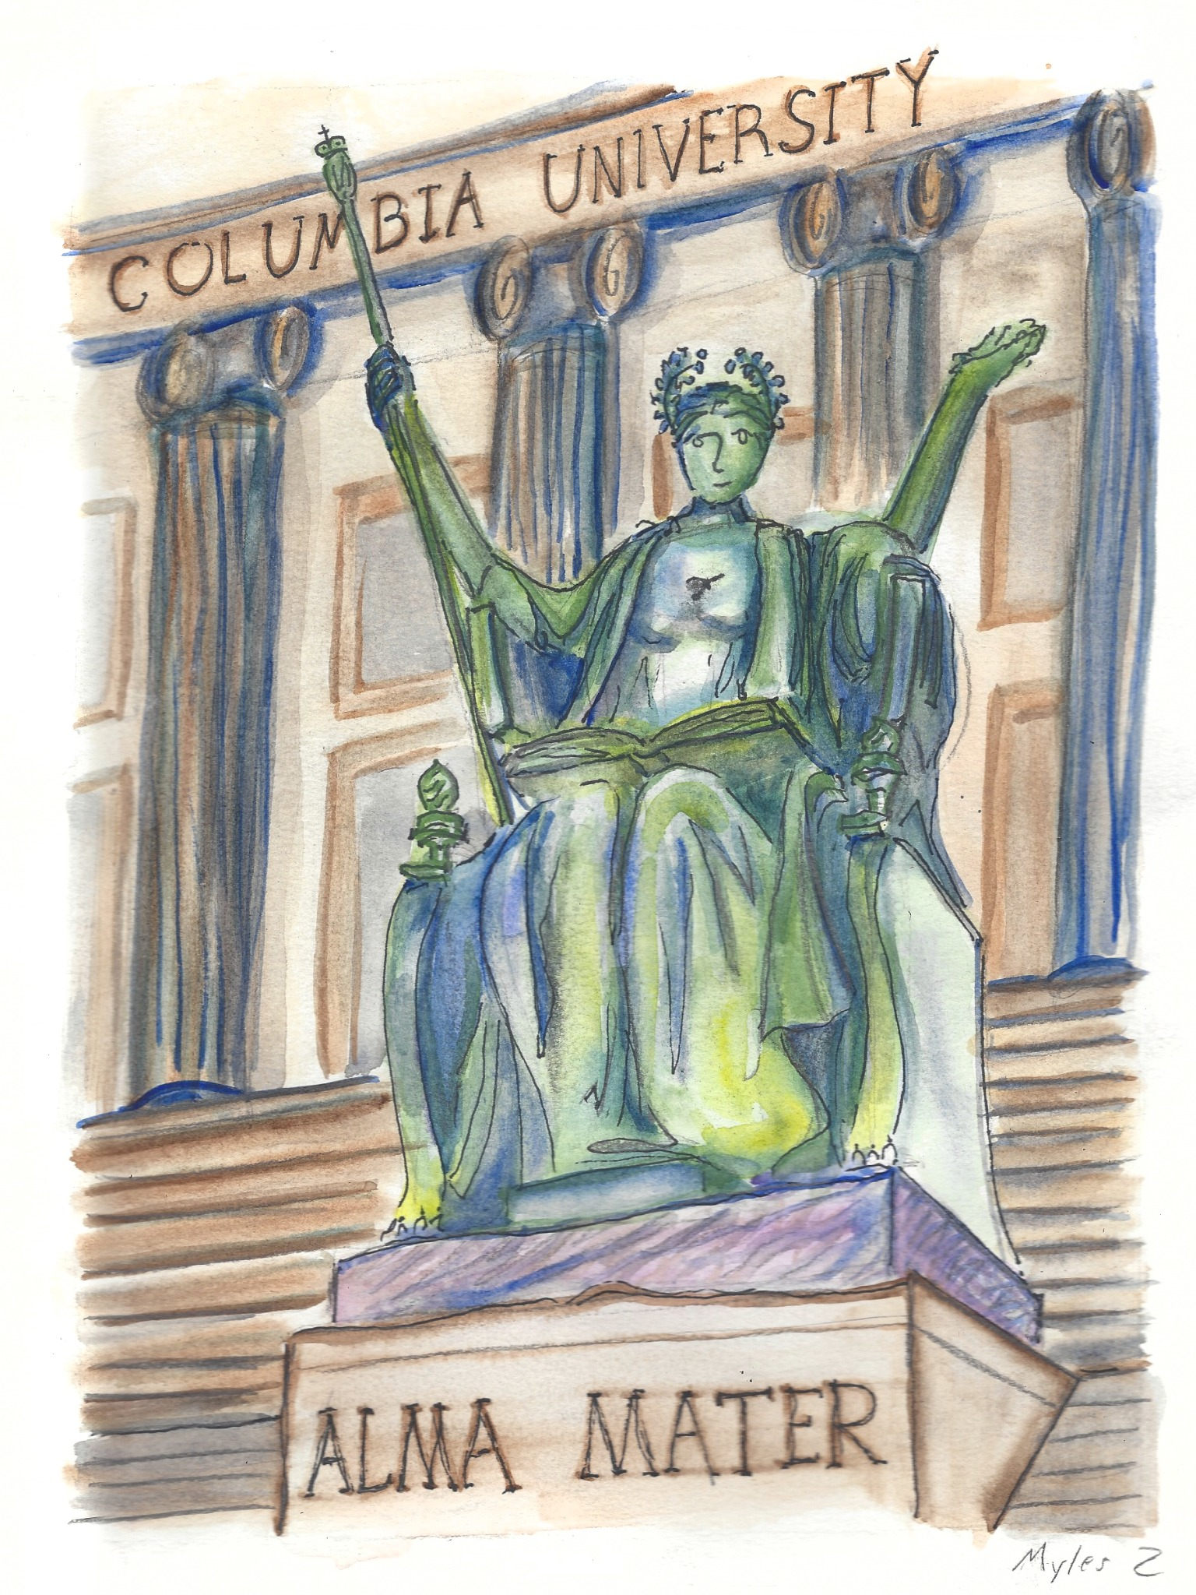

Sunday Finance Seminar:
The Case for an AI Bubble
1

Slide 2
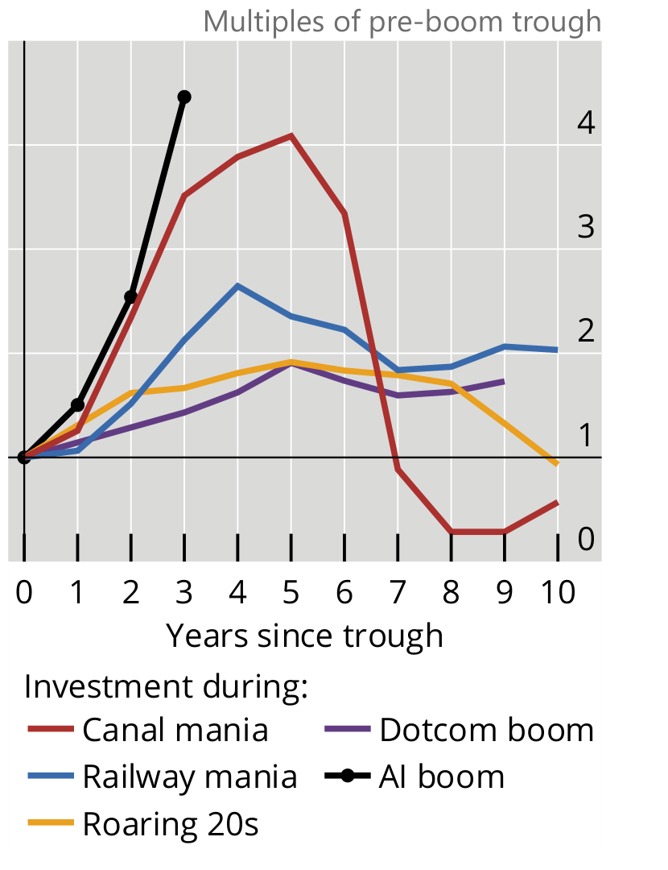
Transformative technologies can still overboom
“The technology is real” has never implied “the contemporaneous capital allocation was correct.”
Canals: genuine network infrastructure, followed by speculative financing and failures.
Railroads: world-changing transport, repeated manias, bankruptcies, and restructurings.
1920s electrification / utilities: real productivity revolution, but speculative valuations still corrected violently.
Fiber and dot-com: the internet thesis was right; the amount, timing, and ownership of the capital were often wrong.
Multiples of each series at its pre-boom trough (1×); x-axis: years since trough. Series / base years: U.S. canals (1835), British real investment (1843), U.S. private fixed assets (1921), U.S. IT/software investment (1995), AI hyperscaler capex (2023). Different scopes; not shares of GDP.
Source: BIS, Annual Economic Report 2026, Graph 11.C (p. 23); Additional notes to graphs (p. 35).
Notes:
BIS Annual Economic Report 2026, Chapter I, Graph 11.C on printed page 23, "Boom-bust cycles are a regular feature of past major innovations". The additional notes to graphs on printed page 35 specify the data series and trough years: canal mania = US canal construction spending, 1835; railway mania = GB real investment, 1843; roaring 20s = US private fixed asset investment, 1921; dotcom boom = US private fixed investment in information processing equipment and software, 1995; AI boom = AI hyperscalers capital expenditure, 2023. AI hyperscalers 2026 capital expenditure comes from earnings calls and press releases. Y-axis is ratio to the starting trough, not dollars, not share of GDP. Both numerator definitions and baselines differ across booms. Use the chart only to illustrate investment surges and historical reversals, not to rank absolute scale.

Slide 3
The infrastructure bet is historically unprecedented
Average annual infrastructure investment as a share of U.S. GDP
AI buildout, 2025–32
3.63%
Railroads, 1870–90
2.24%
Interstate highways
1.13%
Telecom / fiber
1.10%
Canals
0.66%
Electrification
0.50%
Projected AI infrastructure spending is larger relative to GDP than the major U.S. technology buildouts in this comparison.
Source: Van Nieuwerburgh, “Financing the AI Buildout” (BPEA / NBER, 2026). AI is projected; historical figures are realized average annual investment shares.

Slide 4
U.S. investment growth is increasingly concentrated in AI
Public-company capex, physical construction and GDP growth point to the same narrow investment impulse.
PUBLIC-FIRM CAPITAL EXPENDITURE
Net capex growth since Q1 2024 came from firms classified as AI-positive. Other U.S. public firms collectively reduced investment slightly.
Essentially all
PRIVATE NONRESIDENTIAL CONSTRUCTION
CONTRIBUTION TO REAL GDP GROWTH
11.0%
went to data centers in August 2026, versus 1.7% in 2019.
≈22%
of U.S. real GDP growth over the preceding year came from a proxy for AI investment.
−5.9%
year-over-year change excluding data-center construction.
0.47 percentage points of 2.1% growth after adjustment for imported hardware.
Census construction-spending series; current-dollar annual rates.
J.P. Morgan Asset Management estimate, Sept. 2, 2026.
Investment growth outside the AI-linked buildout is materially weaker.
Sources: San Francisco Fed (May 18, 2026; public firms through Q3 2025); U.S. Census (Aug. 2026; CB&C calculations); J.P. Morgan AM (Sept. 2, 2026).
4
Notes:
Research basis and exact scope for this slide:
1. Public-company capital investment: San Francisco Fed Economic Letter, May 18, 2026, Aakash Kalyani and Huiyu Li, Is Optimism for Artificial Intelligence Boosting Investment? https://www.frbsf.org/research-and-insights/publications/economic-letter/2026/05/is-optimism-for-artificial-intelligence-boosting-investment/ . The authors classify a public firm as AI-positive based on positive AI language in earnings calls, with observations through Q3 2025. They say AI-positive firms accounted for all net capital investment growth since Q1 2024; the rest collectively had slightly negative growth. It does NOT mean all of those firms' spending was specifically on AI. Their sample represents approximately 60% of U.S. nonresidential fixed investment.
2. Construction: Census Bureau C30 August 2026 release (Oct. 1, 2026): https://www.census.gov/construction/c30/current/index.html ; series-derived calculations from https://commercialbuildersandcontractors.com/commercial-construction-spending/ . Aug 2026 private nonresidential construction spending $773.0B SAAR, of which data centers $85.0B, equal to 11.0%. Annual-average share in 2019 was about 1.7%. Private nonresidential construction excluding data centers was $688.1B SAAR in Aug 2026 vs $731.4B in Aug 2025, a -5.9% change. Construction is not solely AI; it excludes computing equipment. 2019 average versus Aug 2026 point-in-time comparison.
3. GDP: J.P. Morgan Asset Management, Stephanie Aliaga, Sept. 2, 2026: https://am.jpmorgan.com/us/en/asset-management/institutional/insights/market-insights/market-updates/on-the-minds-of-investors/how-much-of-the-ai-boom-is-adding-to-us-growth/ . AI-investment proxy contributed 0.47 percentage points to 2.1% year-over-year real US GDP growth during the preceding year, net of imported hardware. Ratio is 22.4%. This is an estimate/proxy, not direct BEA AI data. These three indicators have different universes, denominators and date ranges and must not be added together.

Slide 5
Venture capital is overwhelmingly concentrated in AI
88.8%
63.5%
46.4%
of U.S. VC deal value went to AI in Q1 2026
of full-year 2025 U.S. VC deal value went to AI
of U.S. VC dollars went to internet-specific firms at the 2000 dot-com peak
AI accounted for 42.5% of deals by count, but 88.8% by value in Q1 2026.
Sources: PitchBook–NVCA Venture Monitor (Q1 2026; full-year 2025); dot-com comparison uses contemporaneous U.S. VC data for internet-specific firms in 2000.

Slide 6
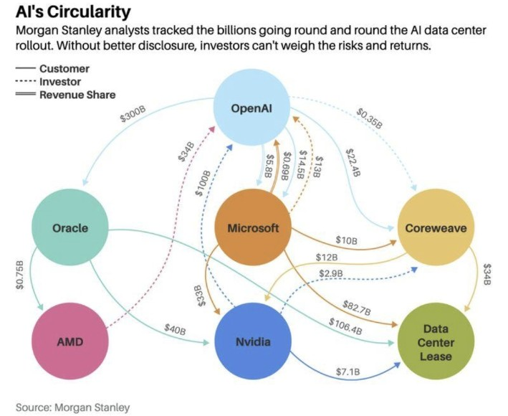
Circular financing ties AI suppliers to their customers
The same companies appear as suppliers, customers, investors and revenue-sharing counterparties.
BIS: CUSTOMER–SUPPLIER RELATIONSHIPS WITH FINANCING
15.2%
of AI compute, cloud and related infrastructure
customer–supplier relationships also involved
financing.
BROAD U.S. COMPARISON
3.3%
of customer–supplier relationships
in a broad U.S. sample involved
direct equity stakes.
Sources: Morgan Stanley, “AI: Mapping Circularity” (Oct. 8, 2025), graphic via Barron's. BIS: Frost et al., “Circular relationships among AI firms,” BIS Bulletin No. 137 (Oct. 1, 2026), footnote 4.
6
Notes:
This slide uses the Morgan Stanley circularity map as the visual anchor. The right-hand statistic now uses the more general comparison from BIS Bulletin 137, footnote 4: 15.2% of AI compute/cloud/related-infrastructure customer–supplier relationships also involved financing, versus 3.3% in a broad U.S. sample of more than 10,000 customer–supplier relationships involving direct equity stakes. The comparison is indicative rather than perfectly matched, but it supports the claim that overlapping financing and commercial relationships are unusually common in this part of the AI buildout.

Slide 7
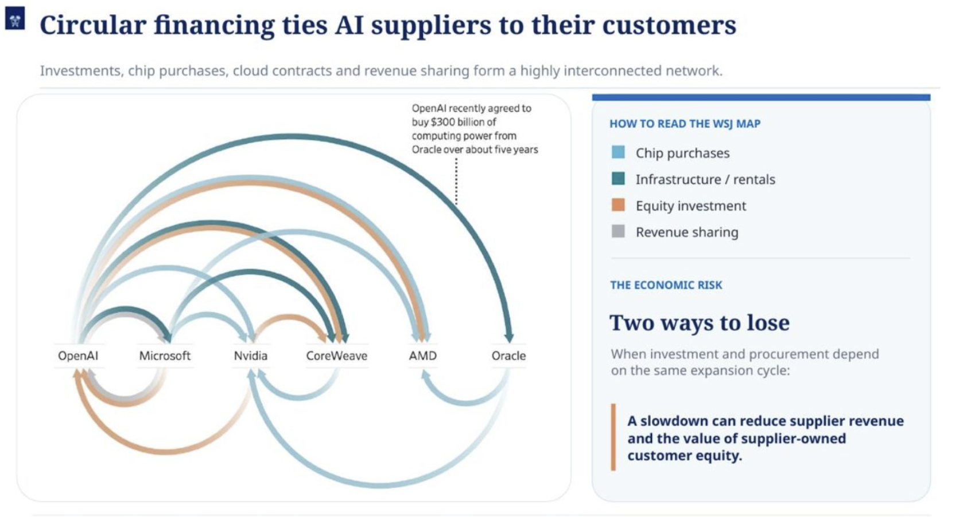
Source: WSJ / Jonathan Weil (Oct. 22, 2025), graphic citing Morgan Stanley; user-supplied exhibit.
7
Notes:
Supporting visual: WSJ / Jonathan Weil (Oct. 22, 2025), graphic citing Morgan Stanley. Use as an intuitive complement to the main Morgan Stanley circularity slide. This version emphasizes the legend and the “two ways to lose” framing: a slowdown can reduce both supplier revenue and the value of supplier-owned customer equity.

Slide 8
Nvidia is backstopping demand for its own AI infrastructure
Nvidia supports AI-cloud capacity and infrastructure through purchase commitments, leases and guarantees.
$36B
$20B
$108.5B
AI-cloud offtake
Third-party data-center leases
Gross contingent guarantees
Cloud capacity commitments, Jul. 2026
Not started; intended to be reassigned
$105B SB Energy + $3.5B other AI clouds
1 COMPUTE-CAPACITY BACKSTOP
2 INFRASTRUCTURE CREDIT BACKSTOP
Nvidia
GPU systems
→
AI cloud
buildout
→
Third-party
compute users
SB Energy
site / leases
→
OpenAI
lease tenant
→
Nvidia
compute
If capacity is not sold to third parties, Nvidia purchases it.
Exposure falls as third-party demand or internal usage rises.
Nvidia guarantees specified lease / power payments on default.
The $105B SB Energy cap activates in phases from FY2029.
The hardware supplier becomes a customer of last resort and a contingent credit-support provider.
Source: Nvidia FY2027 Q2 Form 10-Q, Note 10 and MD&A (Aug. 2026). $20B leases not commenced and intended for assignment; $108.5B maximum gross guarantees.
8
Notes:
Nvidia FY2027 Q2 Form 10-Q, filed August 2026, especially Note 10 (Additional Commitments and Guarantees) and Management Discussion and Analysis:
https://www.sec.gov/Archives/edgar/data/1045810/000104581026000075/nvda-20260726.htm
Main figures: as of July 26, 2026, $36 billion in AI cloud agreements, typically six-year arrangements. The AI-cloud counterparties buy Nvidia infrastructure and Nvidia commits to cloud service agreements, which providers may stop supplying to Nvidia and sell to third parties at more favorable prices. Commitments decline as capacity is used by third parties or Nvidia research. These are capacity/service-purchase commitments rather than direct loans.
As of July 26, 2026, $20 billion in data-center leases not yet commenced for third-party use, with around fifteen-year terms, expected to commence in FY2028-FY2029 and intended to be reassigned. These are not yet active leases, and they are a different category than the guarantees.
Nvidia disclosed aggregate maximum gross land, power and shell guarantee exposure of $108.5 billion: $105 billion signed August 2026 with SB Energy affiliates relating to OpenAI leases at PORTS Technology Campus in Ohio (approximately 4.25GW IT load across nine data centers), plus $3.5 billion of guarantees for other AI-cloud partners. The SB Energy guarantees generally take effect when leases commence, with the first expected in FY2029, and payments are contingent on specified tenant defaults. Coverage is restricted to defined portions of lease/power payments and declines with OpenAI lease performance. This is NOT outstanding borrowing, accrued loss, or a forecast of ultimate payouts.
Why omit CoreWeave from the headline? The initial $6.3B September 2025 CoreWeave/Nvidia order form is a specific example of residual-capacity purchase support, but the public record does not establish that it is the largest. It is also a differently dated transaction, and it should not be mechanically added to or assumed contained within the $36B portfolio. Primary source: https://www.sec.gov/Archives/edgar/data/1769628/000176962825000047/crwv-20250909.htm
Presentation conclusion: Nvidia supports the buildout through supplier sales alongside commitments to consume capacity, provision long-term leasing relationships for third-party assignment, and guarantee a defined fraction of tenant obligations. These are separate exposures; the figures should not be summed as currently funded spending or economic loss.

Slide 9
Now give the bull side its strongest assumptions.
Assume AI is genuinely transformative.
Assume the aggregate infrastructure buildout is economically justified.
But that still doesn’t mean current valuations reflect the ultimate winners.

Slide 10
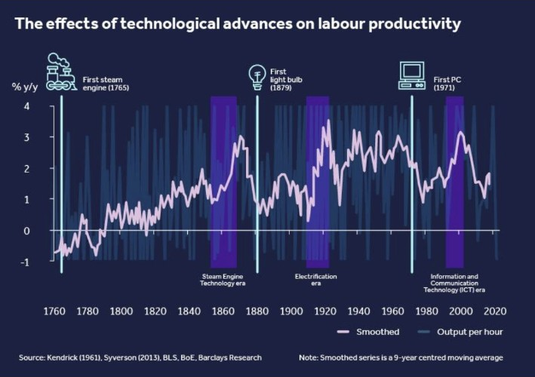
The productivity J-curve
General-purpose technologies require complementary capital, organizational redesign, diffusion, and learning before the measured productivity payoff appears.
The technology can be economically transformative even while measured productivity remains weak early in adoption.
Complementary investment and organizational change occur before much of the output gain becomes visible.
That means the cash-flow horizon supporting today’s AI valuations may extend well beyond the life of today’s competitive advantages.
The question is whether today’s moats survive long enough to realize rents.
Historical figure: Barclays Research / IBM, “AI revolution: productivity boom and beyond” (2024). Concept: Brynjolfsson, Rock & Syverson, “The Productivity J-Curve.”

Slide 11
What drives the productivity J-curve?
AI is a general-purpose technology: firms must build complementary intangible capital before the productivity payoff is fully realized.
The early phase is investment-heavy and output-light
And the aggregate data still look like the early phase
1 Redesign the organization
Firms rework business processes, decision rights, products, and workflows around the new technology.
2.2%
2 Integrate the technology
U.S. private nonfarm business
labor-productivity growth in 2025
Data, software, controls, and operating systems have to be rebuilt or connected before AI can scale.
3 Build human capital
2.0%
1.5%
Workers need new skills, managers need new practices, and firms learn where the technology actually creates value.
1987–2025
average
2007–2019
average
Those costs arrive first. The intangible assets they create are poorly measured, while the output gains arrive later.
Positive, but not yet an extraordinary AI-era productivity breakout.
In a nutshell the J-curve predicts that real productivity gains lag the immense investment that is put into transformative technologies
Sources: Brynjolfsson, Rock & Syverson, “The Productivity J-Curve” (AER: Macroeconomics / NBER); U.S. Bureau of Labor Statistics, Total Factor Productivity 2025, Tables A–B.
11

Slide 12
The valuation horizon is longer than the moat half-life
The productivity lag creates time for the competitive structure to change before the rents arrive.
Major economy-wide productivity gains are a multi-year diffusion story.
Chip architectures, model leads, inference prices, and switching costs can change in months to a few years.
Current valuations therefore capitalize far-future rents using competitive advantages observed in a much earlier regime.
“A moat that does not survive until the productivity horizon is not the moat supporting the valuation.” –AI Sun Tzu

Slide 13
AI compute is commoditizing from two directions
Nvidia does not merely face other GPUs. A growing share of AI workloads can move to custom accelerators that bypass GPUs entirely.
1 Direct GPU competition
2 AI ASICs bypass the GPU layer
Even if GPUs remain central, Nvidia faces growing competition from other GPU suppliers.
AI ASICs emerge from chip suppliers and from hyperscalers designing silicon around high-volume workloads.
AMD Instinct MI400
For a fixed specialized task, ASICs can deliver equivalent capability at lower cost and higher energy efficiency by stripping out GPU flexibility overhead.
Frontier-AI GPU family with HBM4 and an open ROCm software stack.
27.8%
→
~40%
2028
Intel GPU D-Series (Crescent Island)
Inference-focused GPUs targeting lower-cost, power-efficient deployment in existing data centers; customer sampling in 2026.
ASIC-based AI-server
shipments, 2026
Forecast share
by 2030
ASIC unit shipments
> GPU shipments
Chinese GPU competitors
Moore Threads, MetaX, Biren and Iluvatar CoreX are scaling commercial GPUs, expanding production capacity and developing independent software ecosystems, posing a growing long-term threat to Nvidia's market share and pricing power.
Hyperscaler / customer ASIC examples
Google
AWS
Meta
OpenAI + Broadcom
China AI-chip shift: Nvidia ~95% (2021, Huang); all foreign suppliers incl. Nvidia/AMD 34% (2025) → 21% (2026 forecast, TrendForce).
TPU
Trainium
MTIA
Jalapeño
Nvidia will likely face a double loss in market share: GPU competition and GPU cannibalization by ASICs, where it has negligible market share.
Sources: TrendForce (Mar. 18, 2026): ASIC-based AI servers 27.8% of shipments in 2026, nearly 40% by 2030. Omdia (Aug. 21, 2026): custom AI-ASIC unit shipments forecast to exceed GPUs in 2028. Google Cloud documents TPUs as purpose-built ASICs optimized for ML matrix operations and cost-efficient serving; AWS reports Trainium workloads with lower training cost and higher energy efficiency versus GPU machines. Examples: Google TPU; AWS Trainium; Meta MTIA; OpenAI–Broadcom Jalapeño; AMD Instinct MI400; Intel D-Series (Jon Peddie Research, Oct. 2026). China share: Huang, Computex (May 2025); TrendForce via SCMP (June 25, 2026).
13
Notes:
Slide 13: GPU competition includes AMD Instinct MI400, emerging Chinese GPU competitors, and Intel GPU D-Series (Crescent Island). Intel D-Series is a prospective inference-focused GPU alternative; customer sampling was reported in October 2026. Do not describe it as an established volume supplier or assert a verified Nvidia-equivalent cost per token. Jon Peddie Research, October 14, 2026, “Intel’s D270 puts inference in ordinary racks”; Futurum Group, October 19, 2026, “Intel D-Series GPUs Make HBM Optional for Agentic Inference.” Intel Gaudi 3 is not included among the slide examples. Right-hand figures and forecasts refer to custom AI ASICs across the industry and not to Intel D-Series GPUs.

Slide 14
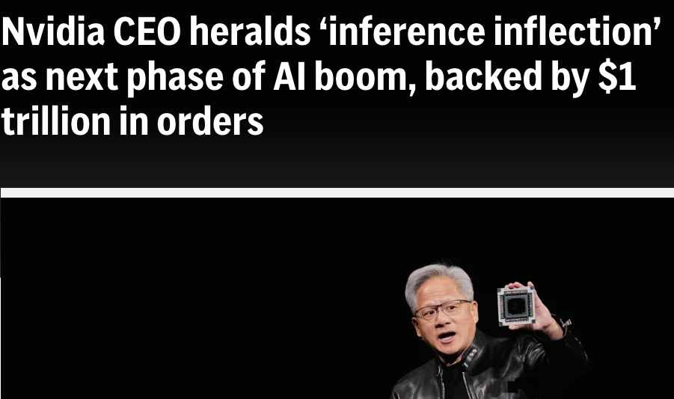
The hype: demand beyond a 70% growth year
“Our demand is much greater than 70%, our supply allows us to confidently deliver 70%.”
Jensen Huang, CEO • Q2 FY2027 earnings call, August 26, 2026 • Transcript p. 8
Source: Nvidia official Q2 FY27 earnings-call transcript, Aug. 26, 2026, pp. 8, 13–14. Management outlook, not independent demand verification or market consensus.
14
Notes:
Primary source: NVIDIA Q2 FY2027 earnings call, August 26, 2026, official corrected transcript: https://investor.nvidia.com/files/content_files/TRANSCRIPT_-NVIDIA-Corp-NVDA-US-Q2-2027-Earnings-Call-26-August-2026-5_00-PM-ET.pdf . Huang quotation about demand and supply capacity appears on printed page 8. He discusses FY2028 revenue growth, not stock returns. Page 8 discusses sovereigns, neoclouds, start-ups and enterprises and the planning needed for land, power and shell. Printed pages 13-14 discuss agents and supply constraints. Summaries explicitly describe management claims, not independently verified demand, a market consensus, a guarantee, or a market-implied requirement to beat consensus. Fiscal 2028 ends January 2028 and largely corresponds to calendar 2027. The word hype denotes the bullish narrative being examined, not an allegation that the quotation or outlook is fabricated. No Yahoo Finance forecast or single-bank revenue forecast is used on these two slides.

Slide 15
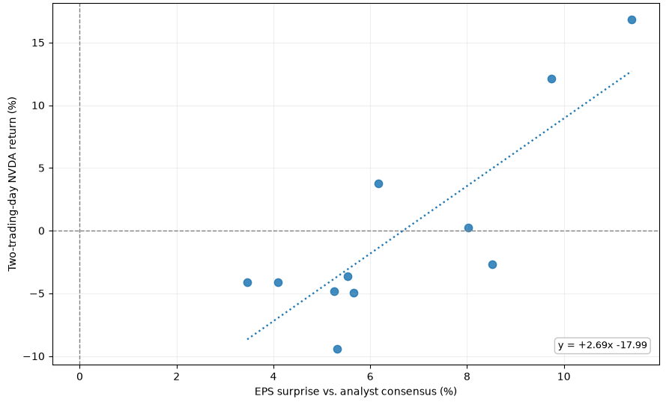
The expectation is that Nvidia beats expectations.
15 consecutive positive EPS surprises; the size of the beat increasingly matters.
EPS ESTIMATES VS. RESULTS
EPS SURPRISE VS. TWO-DAY NVDA RETURN
Recent quarters | Normalized diluted EPS
Quarter | Est. EPS | Actual | Surprise
Q3 FY26 | $1.26 | $1.30 | +3.46%
Q4 FY26 | $1.54 | $1.62 | +5.32%
Q1 FY27 | $1.77 | $1.87 | +5.54%
Q2 FY27 | $2.09 | $2.22 | +6.16%
FITTED BREAK-EVEN BEAT
+6.7%
EPS surprise at zero
fitted two-day return
Historical linear fit · 11 reported quarters
The fitted stock reaction turns positive only around a +7% EPS beat.
Sources: Yahoo Finance / S&P Global Market Intelligence, normalized EPS estimates and actuals; Yahoo adjusted NVDA closes. OLS: return = 2.69 × surprise − 17.99 (percentage points), n=11. Correlation is descriptive; zero/negative EPS surprises are outside this plotted sample.
Notes:
The fitted model is 2-day return (%) = 2.69 * EPS surprise (%) - 17.99, hence zero fitted return at +6.69%. A descriptive OLS estimate from 11 observations, not a deterministic minimum surprise, nor an estimate applicable to zero/negative surprises beyond the sample. All 11 displayed surprises are positive, about 3.46% to 11.40%. The stock reacts to other information including revenue, guidance and risk appetite. Four-quarter EPS values derive from the user-supplied Yahoo Finance yfinance get_earnings_dates output. Chart sourced from user-supplied screenshot and preserved without changing underlying data, except cropping its old title and uniform scaling.

Slide 16
How big exactly are Nvidia’s projections?
Simply meeting consensus already demands extraordinary revenue growth.
NVIDIA ANNUAL REVENUE: ACTUAL VS. CONSENSUS EXPECTATION
Already embedded in
consensus
USD billions | Nvidia fiscal years ending in January
$903B
+90.6%
800
$692B
FY2027 projected growth
600
+68.2%
$412B
400
FY2028 projected growth
$216B
200
+30.5%
FY2029 projected growth
0
FY2026
FY2027E
FY2028E
FY2029E
ACTUAL
CONSENSUS
CONSENSUS
CONSENSUS
The question is not whether revenue grows, but whether it exceeds this trajectory.
Sources: Nvidia FY2026 annual revenue ($215.94B) from company results. Analyst consensus revenue estimates: FY2027E $411.65B, FY2028E $692.21B, FY2029E $903.19B. Growth rates are year-over-year analyst consensus growth.
16

Slide 17
Nvidia’s projections in perspective.
Compare Nvidia's projected sales with forecast operating cash flow across S&P 500 nonfinancial companies.
S&P 500 EX FINANCIALS: CASH FLOW
NVIDIA REVENUE: ANALYST CONSENSUS
≈$4.7T
FY2027E
$412B
2028E | Operating cash flow
FY2028E
$692B
Approximate sum of Apollo / FactSet sector estimates. Technology and telecom alone: ≈$2.4T.
FY2029E
$903B
≈19%
Nvidia FY2029E sales / S&P 500 ex-financials 2028E operating cash flow
$903B ÷ ≈$4.7T | Comparison of projected annual flows
This is only one company in one layer of the AI stack.
Competing GPUs/ASICs, facilities, power, networking, model development and operations also require spending.
Cash flow is before capex; it is not a spending ceiling. Nvidia sales include non-AI uses and non-S&P/foreign buyers.
Source: Apollo Chief Economist / FactSet (Sept. 29, 2026; approximate sum of sector forecasts).
17

Slide 18
What if the earnings surprise is zero—or negative?
With the fitted trend, Nvidia can still grow ~70% in FY2028 and another +15% in FY2029 and still face a ~50% repricing.
FY2029 REVENUE STRESS SCENARIOS
≈−50%
Consensus FY2029 sales: $903B | FY2028 sales: $692B
Despite being out of sample, a ~50% correction is not unrealistic, as implied by the current trend.
Scenario
FY2029
revenue
FY2029
growth
Quarterly
shortfall
Revenue
miss
Fitted
return
Consensus met
$903B
+30.5%
$0B
0.0%
−18%
Half FY2029 growth
$798B
+15.2%
$26B
−11.7%
−49%
Nvidia could grow revenue another ~70% in FY2028 and a further 15% in FY2029, yet still suffer a catastrophic repricing if it falls short of current expectations.
Flat at FY2028
$692B
0.0%
$53B
−23.4%
−81%
The half-growth case still delivers +15% FY2029 sales growth after +68% in FY2028 and +90.6% in FY2027.
18

Slide 19
Frontier-model leadership is measured in months; valuations in years
≈1 year
≈4 months
Open-weight models trail the frontier by months
Epoch Capabilities Index (ECI)
Open-model capability lag in 2024
(Epoch, multiple measures)
Open-weight capability lag, Jan–May 2026
(Epoch ECI)
160
GPT-5.5 Pro
150
o3
Kimi K2.6
2026: open models keep closing in
Qwen3
140
o1-mini
DeepSeek-R1
• July: Kimi K3 reached near-frontier benchmarks with open weights.
• September: four open-weight models ranked immediately behind the four closed leaders.
• October: Kimi K3.1 Pro scored 55 vs. 53 for GPT-6 Astra and Claude Fable 5.1 (Artificial Analysis); weights due Nov. 4.
• Convergence operates on release-cycle timescales, not valuation horizons.
Claude 3.5
130
GPT-4
Llama 3.1
120
Mixtral 8x7B
110
Llama 2
The premium on frontier superiority must be earned in months, while valuations often assume years.
Jan 2023
Jul 2023
Jan 2024
Jul 2024
Jan 2025
Jul 2025
Jan 2026
Closed-weight
Open-weight
Epoch series ends May 2026; later releases not plotted.
Sources: Epoch AI, “How far behind are open models?” (Nov. 2024) and Edwards & Emberson (May 2026); Moonshot, Kimi K3 (July 2026), K3.1 Pro (Oct. 23, 2026); Mozilla (Sept. 2026); Artificial Analysis (Oct. 23, 2026). 2024/2026 lag methodologies differ; K3.1 Pro weights not yet released.
Notes:
October 2026 update: Artificial Analysis (October 23, 2026) scored Moonshot Kimi K3.1 Pro 55 on its Intelligence Index versus 53 for GPT-6 Astra (max) and Claude Fable 5.1. K3.1 Pro was fourth overall, behind Claude Opus 5.5 (58), Claude Sonnet 5.5 (56), and Muse Wonder Full (56). The K3.1 Pro weights were not yet public as of October 25; Moonshot announced release by November 4. The Epoch chart ends May 2026; October benchmark is a separate evaluation system and is not shown in that chart. Sources: https://artificialanalysis.ai/articles/kimi-k3-1-pro-launch-benchmarks ; https://artificialanalysis.ai/leaderboards/models ; https://www.kimi.com/en/blog/kimi-k3-1-pro

Slide 20
Anthropic internal estimates put annual model-training costs near $30B by 2028, before inference expenses.
ANTHROPIC ANNUAL MODEL-TRAINING EXPENDITURE
≈4 months
USD billions | Anthropic internal estimates / projections
~$30B
Open-weight lag behind
the closed frontier in
early 2026 (Epoch)
30
~$23B
20
>$12B
On top of training
10
$4.1B
Inference, personnel and
other expenses are
additional; this chart is
training only.
2025
2026
2027
2028
Company estimates / projections
Recurring training bills require durable rents, while frontier capability gaps can narrow on release-cycle timescales.
Source: The Information (Dec. 2025; Jan. 27, 2026), reporting Anthropic internal estimates / forecasts; Epoch AI (Feb. 2026) for the open-weight lag comparison. 2025 is a near-year-end company estimate; 2026–2028 are internal company projections. Figures are approximate and exclude inference.
20

Slide 21
The model layer is being commoditized from both sides
Open and distilled models reduce the premium attached to proprietary frontier access.
Chinese models increasingly approach frontier capability at dramatically lower API prices.
Meta can rationally commoditize the model layer because it monetizes through advertising, distribution, devices, and engagement rather than model API margins.
The price of useful intelligence can fall even while total AI consumption and productivity value rise.
Illustrative API list prices per 1M tokens
Model
Input
Output
GPT-6 Astra
$10.00
$50.00
Claude Opus 5.5
$4.00
$20.00
Qwen3.5 Plus
$0.115
$0.688
AI can become more valuable to the economy while model-provider rents compress.
Sources: current official OpenAI, Anthropic, and Alibaba Cloud pricing; Stanford / Epoch cost comparisons.

Slide 22
A conservative basket worth 10 trillion.
Only firms whose valuations depend heavily on current compute scarcity, frontier-model leadership, or hyperscale AI economics.
Company
Approx. value
Excluded by construction
≈ $10T
Nvidia
~$5.09T
• AI startups
• Other AI hardware / semiconductor firms
• AI-attributable value inside diversified frontier competitors:
Alphabet / Google
Amazon
Microsoft
Meta
illustrative current / latest private-market value
SpaceX / xAI
~$2.0T
OpenAI
~$1.4T
Anthropic
~$1.5T
These omissions make the basket conservative: none of their AI-related valuation is counted.
Illustrative bear scenarios put $4.74T–$8.02T of value at risk within this narrow basket, before wider market spillovers.
Notes:
Latest available market cap for NVDA: $5.094T at the October 23 2026 close ($210.96/share); YCharts NVDA Market Cap; other reference private valuations retained from the deck. Total basket $9.994T. Hypothetical relative-price repricing uses the prior slide regression, not fundamental fair-value estimates. This is not an independently verified bubble kernel.

Slide 23
Conservative bear: slower implies puts $4.74T at risk
Nvidia grows +68% in FY2028 and +15% in FY2029, versus +30.5% FY2029 consensus. Apply the fitted ~49% correction.
NVIDIA
FRONTIER AI
SPACEX CORE
$2.58T
$1.00T
$1.68T
FY2029 sales $798B | -11.7% vs consensus
OpenAI, Anthropic, xAI
Launch and connectivity
Historical EPS regression mechanically implies a ~49% equity haircut (out of sample).
Talent, infrastructure, and customer advantages persist
Morgan Stanley: 52× 2028E EBITDA
(very generous multiple)
Valuation of selected four-company basket
Scenario value $5.26T
Potential repricing $4.74T
Illustrative valuation at risk: $4.74T (47.4% of the $9.99T basket)
Sources: Nvidia cap $5.094T (Oct. 23, YCharts); FY2029 consensus $903.19B (MarketScreener); fitted return ≈−49.4% (out of sample); Morgan Stanley SpaceX core estimate.
23
Notes:
FY2029 conservative scenario, not a stock-price forecast. Baseline NVDA market cap $5.094 trillion as of October 23 2026 (YCharts, $210.96 share price). FY2028 sales consensus $692.21B; FY2029 sales consensus $903.19B. Scenario FY2029 revenue $797.700B; miss relative to FY2029 consensus -11.6797%. Previous slide line fitted to 11 observations with *positive EPS surprises*, two-day NVDA returns: r_percent = 2.69 * surprise_percent - 17.99. Mapping a hypothetical annual revenue miss to an EPS surprise is not empirically validated, and extrapolating to negative surprises is outside the observed sample. Mechanical fitted correction -49.4084%; Nvidia value $2.577135T. Other assumptions retained from previous version: Frontier AI residual $1.00T (OpenAI, Anthropic, xAI), SpaceX core $1.68T. Initial basket = NVDA $5.094T + SpaceX/xAI $2T + OpenAI $1.4T + Anthropic $1.5T = $9.994T. Combined scenario value $5.257135T; hypothetical basket mark-to-market loss $4.736865T (47.3971%). This represents a modeled equity haircut relative to latest market values, not a fundamental value estimate, prediction of a two-day crash in 2029, or a statistical confidence bound. Source estimates: YCharts Oct 23 2026, MarketScreener FY2029 consensus, Morgan Stanley Aug 2026 SpaceX space and connectivity $1.68T (conservative), Reuters February 2026 SpaceX $1T pre-xAI benchmark (extreme).

Slide 24
Extreme bear: flat FY2029 implies $8.02T at risk
Nvidia reaches FY2028 consensus, then revenue stalls at $692B in FY2029 rather than rising to $903B (+30.5%).
NVIDIA
FRONTIER AI
SPACEX CORE
$0.98T
$0
$1.00T
FY2029 sales $692B | -23.4% vs consensus
OpenAI, Anthropic, xAI
Launch and connectivity
Historical EPS regression mechanically implies a ~81% equity haircut (out of sample).
Zero residual equity value after commoditization
Reuters Feb. 2026 pre-xAI value
(transaction benchmark)
Valuation of selected four-company basket
Scenario value $1.98T
Potential repricing $8.02T
Illustrative valuation at risk: $8.02T (80.2% of the $9.99T basket)
Sources: Nvidia cap $5.094T (Oct. 23, YCharts); FY2029 consensus $903.19B (MarketScreener); fitted return ≈−80.8% (out of sample); Reuters pre-xAI SpaceX benchmark.
24
Notes:
FY2029 extreme scenario, not a stock-price forecast. Baseline NVDA market cap $5.094 trillion as of October 23 2026 (YCharts, $210.96 share price). FY2028 sales consensus $692.21B; FY2029 sales consensus $903.19B. Scenario FY2029 revenue $692.210B; miss relative to FY2029 consensus -23.3594%. Previous slide line fitted to 11 observations with *positive EPS surprises*, two-day NVDA returns: r_percent = 2.69 * surprise_percent - 17.99. Mapping a hypothetical annual revenue miss to an EPS surprise is not empirically validated, and extrapolating to negative surprises is outside the observed sample. Mechanical fitted correction -80.8269%; Nvidia value $0.976680T. Other assumptions retained from previous version: Frontier AI residual $0.00T (OpenAI, Anthropic, xAI), SpaceX core $1.00T. Initial basket = NVDA $5.094T + SpaceX/xAI $2T + OpenAI $1.4T + Anthropic $1.5T = $9.994T. Combined scenario value $1.976680T; hypothetical basket mark-to-market loss $8.017320T (80.2213%). This represents a modeled equity haircut relative to latest market values, not a fundamental value estimate, prediction of a two-day crash in 2029, or a statistical confidence bound. Source estimates: YCharts Oct 23 2026, MarketScreener FY2029 consensus, Morgan Stanley Aug 2026 SpaceX space and connectivity $1.68T (conservative), Reuters February 2026 SpaceX $1T pre-xAI benchmark (extreme).

Slide 25
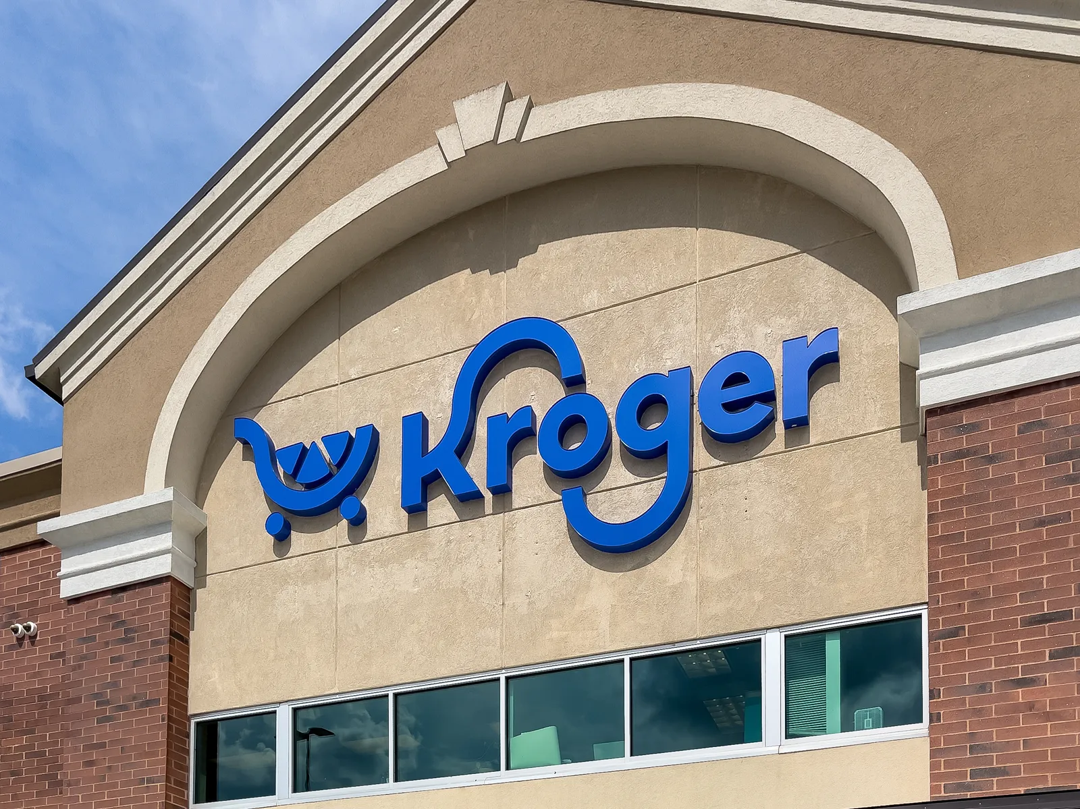
“They can pivot” does not defend the present valuation
If the current moat is expected to disappear before the major productivity rents arrive, the valuation can no longer be justified by that moat.
A future pivot is an option on management finding a new rent-generating mechanism. It is not evidence that the current one persists.
Once the future moat is unspecified, the basis for assigning these particular firms trillions of dollars of the eventual AI surplus becomes little better than assigning extraordinary option value to any capable incumbent.
Reductio
We would not value Kroger at $5T because competent management might discover the dominant business model of 2035.
If today’s premium is attached to advantages that do not survive the valuation horizon, that is the capital misallocation.

Slide 26
Bubble kernels vs crash footprints
Compare historical misvaluation estimates with an illustrative AI valuation-repricing stress range.
Misvaluation / scenario repricing
Temporary destruction during the crash
$11T
$130T
?
~$4.74–8.02T
~$6.1T
~$50T
~$3.7T
~$8.4T
Dot-com
misvaluation
2008 real-estate
misvaluation
AI repricing
scenarios
Dot-com
crash losses
2008 crisis
losses
AI
Historical dollar figures are nominal and use differing asset universes. AI $4.74T–$8.02T is an illustrative marked-to-market repricing, NOT a fundamental misvaluation estimate or calibrated forecast. Scenario uses Oct. 23 Nvidia cap (YCharts), FY2029 revenue consensus (MarketScreener), and a positive-EPS-only fitted reaction line.
26

Slide 27
Estimating contagion: Nvidia
Focus on Nvidia alone: how might a collapse propagate through the broader market?
HISTORICAL WEEKLY RETURN RATIOS
ILLUSTRATIVE −50% NVDA SHOCK
Nasdaq Composite / Nvidia | Conditioned on absolute weekly NVDA moves
Median ratio in the >8% sample: 0.440×
NVDA weekly move | Weeks | P25 | Median | P75
> 3% | 59 | 0.143× | 0.396× | 0.534×
> 5% | 35 | 0.221× | 0.396× | 0.534×
> 8% | 15 | 0.282× | 0.440× | 0.534×
> 10% | 5 | 0.414× | 0.445× | 0.449×
−22.0%
Implied Nasdaq Composite move
≈ $10.0T
• Oct. 2026 comparison: the recent Nvidia correction fell almost exactly in line with the trend — NVDA −11.8% (−13.6% intraday) vs. Nasdaq −6.0% (−6.7% intraday), implying 0.50× / 0.49×
EVEN TAIL-CONDITIONED RATIOS MAY UNDERSTATE A COLLAPSE
These quantiles already condition on large Nvidia moves, but a 50–80% collapse lies far beyond the observed weeks. It could trigger cascading forced sales, margin calls and liquidity spirals that the historical ratios do not adequately capture.
27

Slide 28
Conclusion: The Odds Are Good, but the Goods Are Odd
To say there is no bubble and current valuations are broadly correct, the bull case effectively needs all three:
1
AI is transformative enough
to justify a historically unprecedented buildout relative to GDP.
2
The buildout is not materially overdone
despite repeated examples of real technologies overbooming.
3
Today’s leaders retain the rents
or identify durable new moats before the major productivity gains arrive.
AI can transform the world and today’s presumed winners can still be badly overpriced.

Slide 29
Sources
Scale of buildout: Van Nieuwerburgh, “Financing the AI Buildout,” BPEA / NBER, 2026.
VC concentration: PitchBook–NVCA Venture Monitor, Q1 2026.
Productivity J-curve: Brynjolfsson, Rock & Syverson.
Nvidia substitution: TrendForce ASIC-server forecasts; hyperscaler custom-silicon shipment mix.
Model convergence: Stanford AI Index 2025 and 2026 technical-performance chapters.
Model pricing: official OpenAI, Anthropic, Alibaba Cloud pricing pages.
Valuation basket / SpaceX core: public market caps; Morgan Stanley (Aug. 2026), $127/share at 52× 2028E EBITDA; Reuters (Feb. 2026), pre-xAI SpaceX transaction $1T.
Circular financing: BIS Bulletin 137; OpenAI / Amazon announcements; Nvidia / CoreWeave filings.

